Slide 1
Prediciton of Level of Depression of Individuals
AIMT, Lambton College
CBD-2214 – Big Data Fundamental Data Storage Networking
GROUP MEMBERS:
Anil Shah Baniya: C0938253
Rathan Raj Dasari: C0913018
Jignesh Bejjagam: C0935085

Slide 2
Table Of Contents
Abstract
Introduction
Depression based on its Severity
Different forms of Depression
Health consequences of Depression
Effects on Career’s of young and adult people
Methods to Classify Depression State of an Individual
Integrating ML for Preventive measure
Conclusion

Slide 3
Abstract
This project aims to develop a machine-learning model that can classify an individual's depression state using other variables. We are using a dataset called Depression.csv, which has 16 features.
The target feature of our project is the depression state of the individual, and we aim to accurately predict the level of depression (no depression, mild depression, moderate depression, severe depression) based on other features.
Our approach involves preprocessing the data to handle missing values, scaling features for optimal model performance, and training and validating the model using robust machine-learning techniques.
The successful implementation of this model could enhance mental health monitoring and support, contributing to better mental health outcomes.

Slide 4
Introduction
Depression, also referred to as depressive disorder, is a prevalent mental illness. It is characterized by a protracted period of depression, loss of pleasure, or lack of interest in activities. A depressive state is not the same as normal mood swings or feelings related to daily living.
An affective disorder is depression.
Depression is a common but dangerous mood illness. It is often referred to as major depression, major depressive disorder, or clinical depression.
In addition, characteristics such as low energy, difficulty concentrating, feelings of shame or worthlessness, suicidality, and psychotic symptoms may be present.
This project aims to apply one of those machine learning (ML) techniques to develop a model that can classify the state of the Depression based on its severity.

Slide 5
CONTD’
The target feature of our project is the depression state of the individual, and we aim to accurately predict the level of depression (no depression, mild depression, moderate depression, severe depression) based on other features.
Our approach involves preprocessing the data to handle missing values, scaling features for optimal model performance, and training and validating the model using robust machine-learning techniques.
The successful implementation of this model could enhance mental health monitoring and support, contributing to better mental health outcomes.
Detection of Depression is essential, as well as providing the proper treatment. Machine Learning (ML) is one of the emerging technologies that can help find hidden patterns in data using various techniques.

Slide 6
Depression Levels in Canada:
Variability in Symptoms:
The degree of symptoms including sleep disturbance, changes in appetite, interest in activities, exhaustion, feelings of worthlessness, agitation, suicidal ideation, aggression, panic attacks, hopelessness, restlessness, poor energy, and general depressive state varies depending on the age group.
Data Points and Representation:
The dataset covers a wide range of cases (540 entries), providing a comprehensive view of depression across different demographics.

Slide 7
Depression Based on Severity
We took No depression and Mild Depression as a group of ‘0’ and Moderate and Severe depression as a group of ‘1’.
The quantity, intensity, and duration of symptoms, along with how they affect social and professional functioning, all contribute to the severity of depression.
Mild Depression:
Relatively less affected are symptoms like appetite, interest, and sleep.
High scores (5.0) for anger, agitation, tiredness, worthlessness, and suicidal thoughts.
High severity is also shown by sleep difficulty, panic episodes, despondency, and low energy.
Overall, these individuals may have increased emotional anguish and weariness, but they are still able to perform some everyday tasks.

Slide 8
CONTD’
Moderate Depression:
Severe disruption of appetite, interest, and sleep (score of 5.0).
Lower (1.0) ratings for aggression, agitation, weariness, worthlessness, and suicidal thoughts, suggesting these are less affected.
Moderate severity is also shown by sleep difficulty, panic episodes, despondency, and low energy.
Patients are not as emotionally impacted as those with severe depression, yet they nonetheless struggle in many areas.
Severe Depression:
Sleep, appetite, and interest all exhibit signs of moderate disruption (rated 2.0).
Increased levels of exhaustion, inadequacy, anxiety, suicidal thoughts, hostility, and restlessness.
Moderate severity is also shown by sleep difficulty, panic episodes, despondency, and low energy.
These patients have a greater emotional burden and substantial impairment in their ability to function on a daily basis.

Slide 9
General Observations for different states of depression
Severe symptoms frequently group together, which raises the overall severity of depression.
Even little symptoms can have a big influence on day-to-day activities, especially if emotional symptoms are bad.
The spectrum of symptoms in moderate depression is more evenly distributed, reflecting a varied impact on day-to-day functioning and emotional state.
The dataset shows trends in which suicidal thoughts and feelings of worthlessness play a crucial role in assessing the degree of depression.​

Slide 10
HEALTH CONSEQUENCES of depression
Sleep disturbances: Insomnia or hypersomnia, which can negatively impact cognitive and general health, are frequently brought on by depression.​
Changes in Appetite: Whether it's elevated or lowered, altered appetite can lead to variations in body weight, inadequacies in nutrition, and associated health problems including obesity or malnutrition.
Fatigue and Low Energy: Chronic fatigue and low energy are prevalent, which raises the risk of chronic illnesses like diabetes and cardiovascular disease as well as decreasing physical activity.
Suicidal Ideation: Suicidal ideation at high levels is a serious side effect of depression that calls for immediate action to stop self-harm or suicide.

Slide 11
Agitation and Restlessness: Enhanced agitation and restlessness can cause stress and make it harder to interact socially.
Panic Attacks: Depression is often associated with panic attacks, which can cause significant distress and further complicate mental health issues.
Concentration and Cognitive Impairment: Depression can have an adverse effect on daily activities and work performance by impairing cognitive skills like memory, concentration, and decision-making.Reduced Interest in Activities: Social withdrawal and social isolation might result from a diminished interest in once-enjoyed activities.
Feelings of Hopelessness and Worthlessness: These emotional symptoms might worsen mental health disorders by contributing to a depressed and negative self-perception.

Slide 12
Methods to Classify Depression State
Kaggle is one of the open-source platforms for extensive collections of data sets. We downloaded our data set from Kaggle, which provided relevant and adequate information for training our model.
The goal of our project is to identify the depression state of an individual based on other column values
Collected data from verified data sources and we categorized the depression level into two group - 0 for No depression and 1 for Depression.
​Cleaning the Data: If there are any outliers we will remove the data and do normalization.

Slide 13
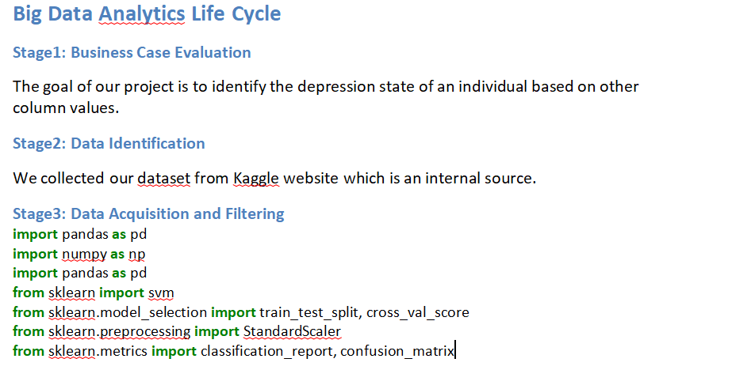

Slide 14
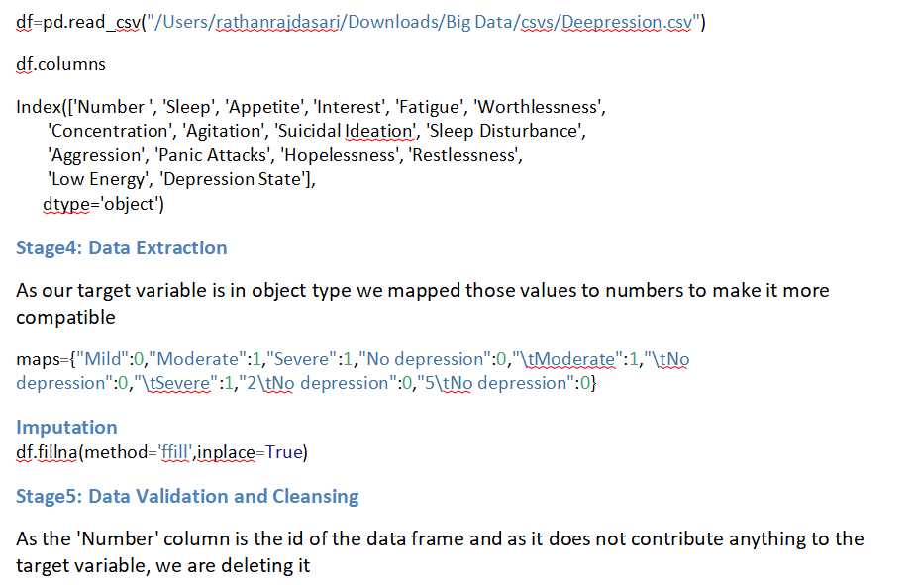

Slide 15
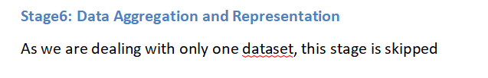
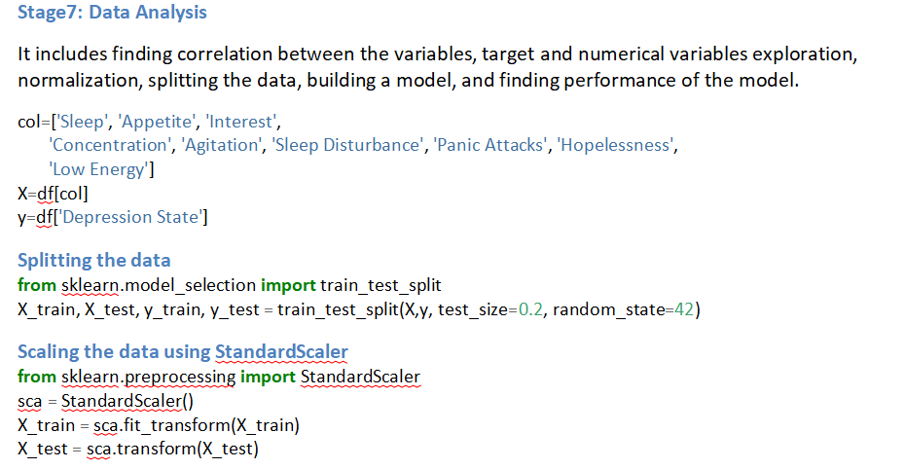

Slide 16
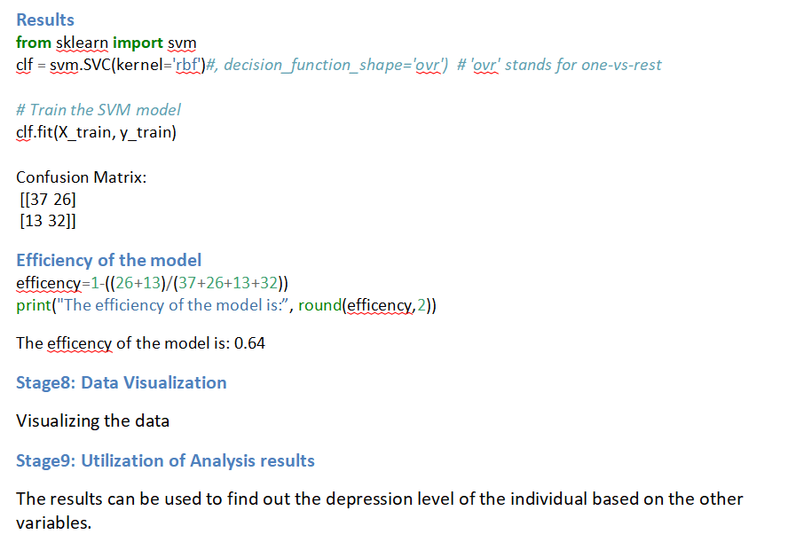

Slide 17
We used correlation method to remove sleep disturbance, fatigue, worthlessness, agression, panic attack, restlessnessopelessness, suicidal ideation because it has no correlation with the target variable.
As the 'Number' column is the id of the data frame and as it does not contribute anything to the target variable, we are deleting it
Normalization: Normalize the composite score if symptoms are scored on different scales.
It includes finding variables exploration, normalization, splitting the data, building a model and finding efficiency of the model.
Symptom Profiles: We can Develop symptom profiles for each depression state based on historical data patterns.
We can perform and predict which feature variable have highest level of depression.

Slide 18
Plotted the histogram for depression state by plt.hist(x=df[‘Depression State’])
Checking if inputs are co-linear to each other or not by using dff=df[col], dff.corr()
Create a pipeline that integrates StandardScaler and the SVM classifier (svm.SVC), ensuring seamless data transformation and model training.
Training the SVM model by using clf.fit(X_train, y_train)
Predict on the training data by y_pred = clf.predict(X_test)
Use classification_report and confusion_matrix to assess the performance of the model, providing metrics like precision, and overall accuracy.
Visualizing the data for example, plt.hist(x=dff['Sleep']).

Slide 19
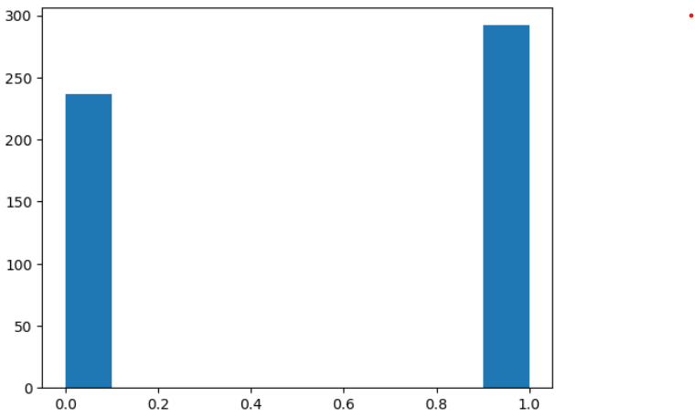
Two different depression states ‘0’ for No depression and Mild depression, ‘1’ for Moderate and Severe depression.
Figure 1. Histogram of the Depression State.

Slide 20
Conclusion
This project aims to develop a reliable model for detecting depression. We applied machine learning to the classification of depression levels of individuals, which involved data pre-processing, cleaning, validation, extraction, and analysis. By using predictive analytics, we perform effective classification to determine depression levels. It also involved StandardScaler for feature scaling, mapping the target variable, and classification using SVC. Finally, we used a confusion matrix to find the evaluation metrics of the model.
Early warning indicators can be found, treatments can be tailored to the individual, and resources can be allocated more effectively by incorporating machine learning into depression prevention approaches.
In addition to improving overall mental health outcomes, this proactive approach can help lower the incidence and severity of depression.

Slide 21
Future Scopes
This model can be integrated with the healthcare systems in assisting treatment and observing depression. Also, it can be combined with the existing mobile mental health applications in the assessment of depression and providing precautionse.
We can use the model in the sensitive areas or at the workplace such as identifying the mood of the person before making surgery, piloting, teachers, drivers.

